Slide 1

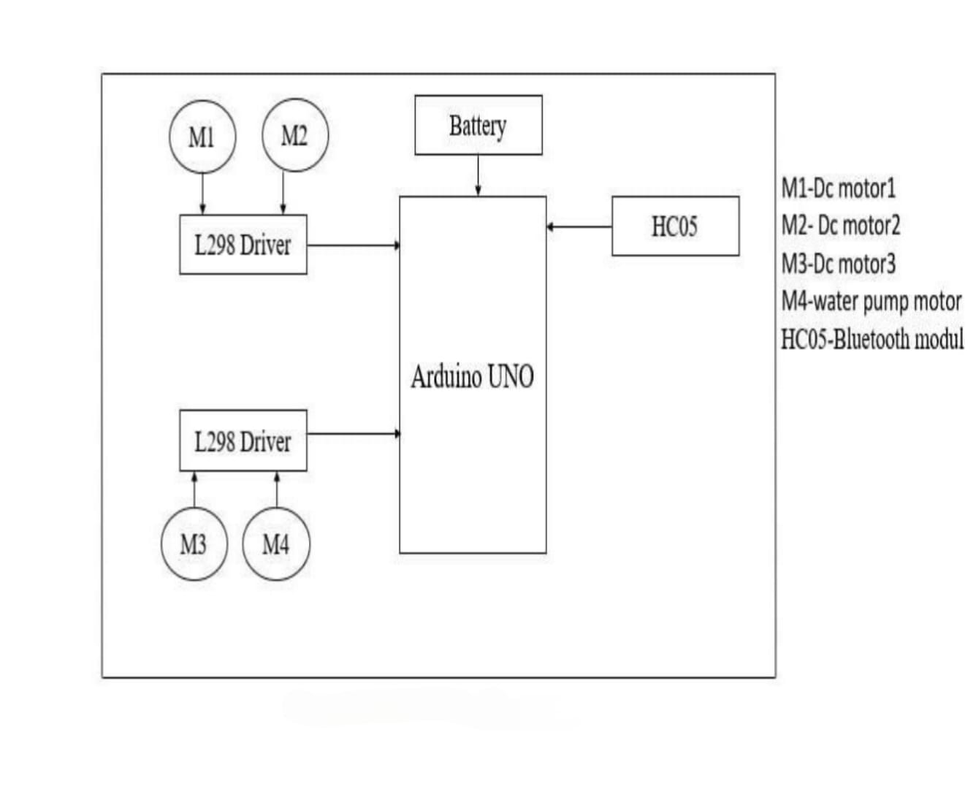
Automatic Seed Sowing and Spraying Agriculture Robot
Batch No: A-14 Roll Nos:21 ,32 ,52 ,56 SRNs: 02FE22BEC020,02FE22BEC032,02FE22BEC054,02FE22BEC058
Student Names: Chandrashekhar Bhavi, Jamuna Pulapatli , Priyanka Budihal , Pruthviraj Banoshi Guide: Dr. Prabhakar Manage
Context:Typically, developing a low-cost, automated seed sowing machine addresses challenges like high labor costs and inefficient seed placement. Integrating mechanical, electrical, and software components enables autonomous soil digging, seed sowing, covering, and watering. Arduino and Bluetooth control allow remote operation via a mobile app. The mild steel structure includes a plough, seed dispenser, and compacting mechanism, powered by a rechargeable battery with optional solar integration. Performance evaluation shows improved efficiency and precision, though challenges in uneven terrains and seed adaptability remain, making it a scalable, cost-effective solution.
Problem Statement : Develop an automatic seed sowing and spraying agriculture robot to enhance efficiency , reduce labour dependency , and ensure precise seed placement for smart farming.
Plough, seed dispenser, and compacting mechanism
Performance evaluation on efficiency and precision
Rechargeable battery with solar option
Deliverables :
arable
Drivable
Basic knowledge of Arduino, Bluetooth communication, and mobile app integration
Understanding of mechanical components and automation in agriculture
Training / Pre-Requisites
Timeline
Starter Reference Material
Agribot: Arduino Controlled Automatic Seed Sowing Machine for Small Scale Cultivation, Avinash kumar Parmar, Talati Chaitanya J.(2024)
Design And Fabrication of Automatic Seed Sowing Machine Using Iot, Viraj Jedhe, Prathmesh Halake(2023)
Automatic Seed Sowing and Spraying Agriculture Robot, Narendra Chaurasia(2023)
Design of Automatic Seed Sowing Machine for Agriculture Sector, Ratnesh Kumara, Aadhar Govil(2022)
Kick Off < 1st Month >
Milestone 1 < 2nd Month >
Milestone 2 < 3rd & 4th Month
Identify requirements and finalize design.
Select components(mechanical,electrical and software).
Develop initial circuit and control system(Arduino & Bluetooth).
Assemble mechanical structure(plough,seed dispenser, spraying system).
Integrate electronics and test mobile app for remote operation.
Conduct field tests for seed sowing and spraying accuracy.
Optimize performance and finalize documentation.

